Slide 1


Social Noti
UWU Mind Blender
Uva Wellassa University

Slide 2
Welcome
To Social Noti Platform
Our Goal
Limit the Time Wastage of social media use.
All the notification from the social media will be on single screen (Facebook,WhatsApp,Youtube).
Reduce the Addiction To the social media invest that waste time to Environment Protection
Separate Platform To Recycle Or Reuse the Plastic
The Solution We give as Recycle Media App with Augmented Reality

Slide 3
Content We Talk
About Social Noti
Recycle Media App
Our prototype
Conclusion
Created by UWU Mind Blenders

Slide 4
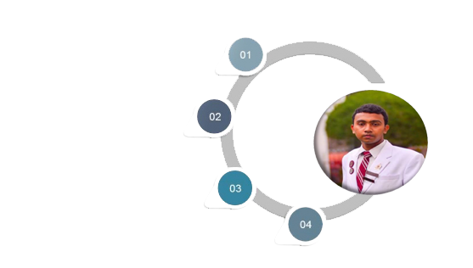
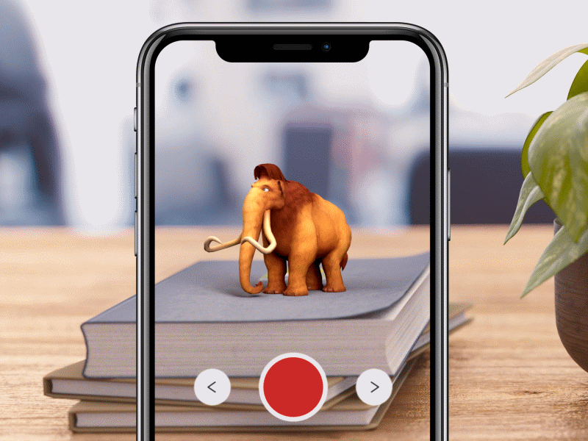







1
About Social
Noti

Slide 5

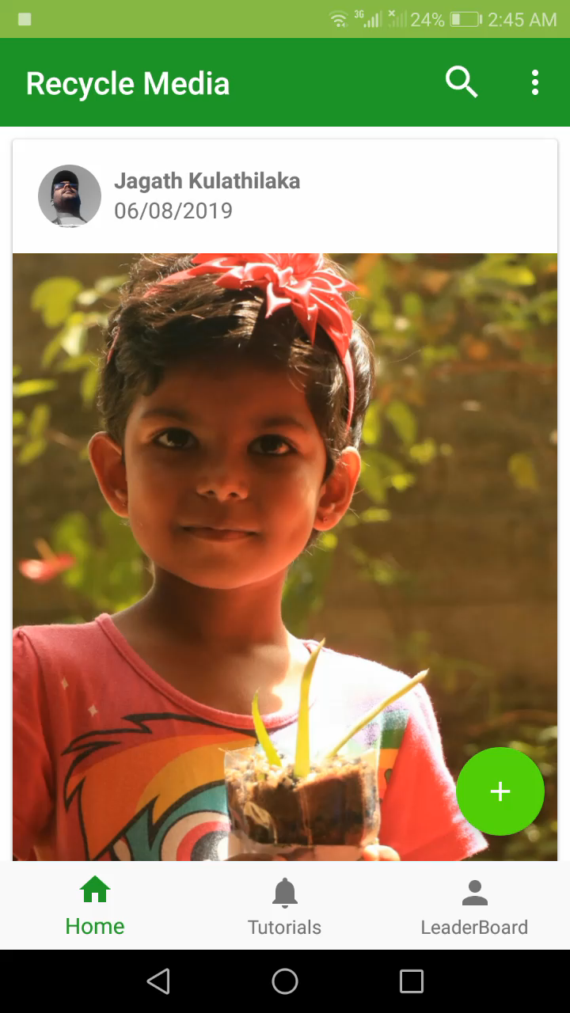

2
Recycle Media App

Slide 6
Familiar Platforms:
Recycle Media Platform
Finally
Facebook
Youtube
Whats App
Like
Comment
LeaderBoard
Innovation With Waste Plastics
Reduce Social Media addiction
Social Noti
Motivate To reduce the Addiction
Notification
Reduce Time wastage
Ease of access

Slide 7

3
Prototype

Slide 8
Gaming
Video production
Mountain climbing
Graphic designing
Volunteer work
Traveling
Photography

Slide 9


4
My ePortfolio Website
New

Slide 10





Contact Us!
9/7, Nalandarama Rd, Nugegoda.
lakshithakavindra.perera
lakshitha1629
lakshitha1629@gmail.com
0779996367

Slide 11

Thank You

